Slide 1


Lab 10
NN, Xavier, Dropout
With PyTorch 0.2.0_2
Sung Kim <hunkim+ml@gmail.com>
Code: https://github.com/hunkim/DeepLearningZeroToAll/

Slide 2
https://github.com/hunkim/DeepLearningZeroToAll/tree/master/pytorch
https://github.com/hunkim/DeepLearningZeroToAll/blob/master/pytorch/lab-10-1-mnist_softmax.py

Slide 3
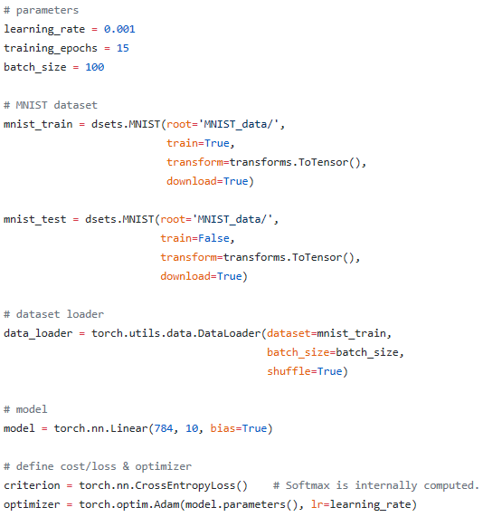
Softmax classifier for MNIST
https://github.com/hunkim/DeepLearningZeroToAll/blob/master/lab-10-1-mnist_softmax.py

Slide 4
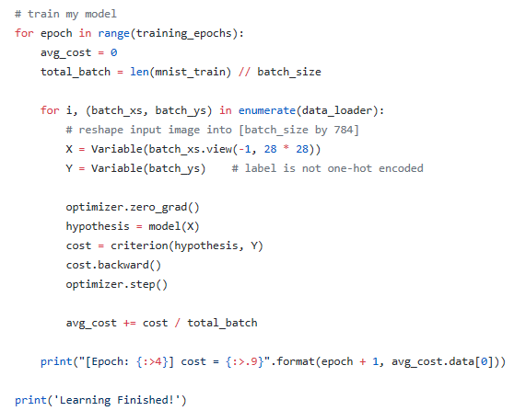
Softmax classifier for MNIST
https://github.com/hunkim/DeepLearningZeroToAll/blob/master/lab-10-1-mnist_softmax.py

Slide 5
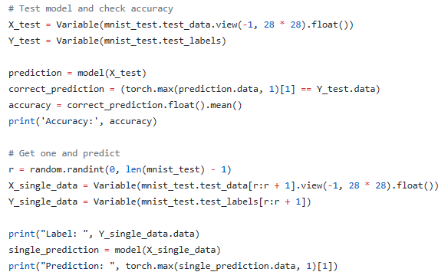
Softmax classifier for MNIST
https://github.com/hunkim/DeepLearningZeroToAll/blob/master/lab-10-1-mnist_softmax.py

Slide 6
https://github.com/hunkim/DeepLearningZeroToAll/tree/master/pytorch
https://github.com/hunkim/DeepLearningZeroToAll/blob/master/pytorch/lab-10-2-mnist_nn.py

Slide 7
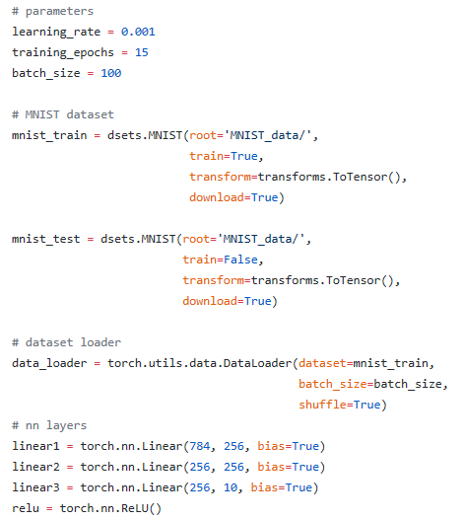
NN for MNIST
https://github.com/hunkim/DeepLearningZeroToAll/blob/master/pytorch/lab-10-2-mnist_nn.py

Slide 8
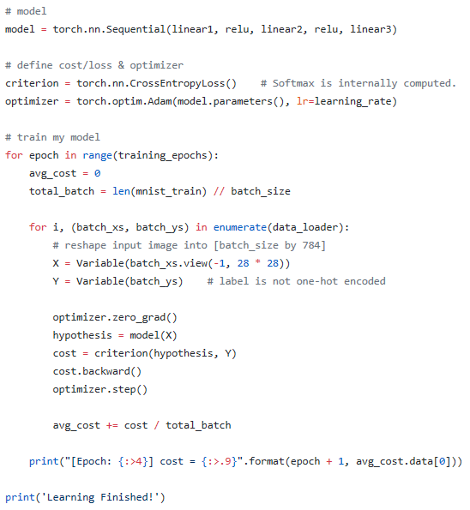
NN for MNIST
https://github.com/hunkim/DeepLearningZeroToAll/blob/master/pytorch/lab-10-2-mnist_nn.py

Slide 9
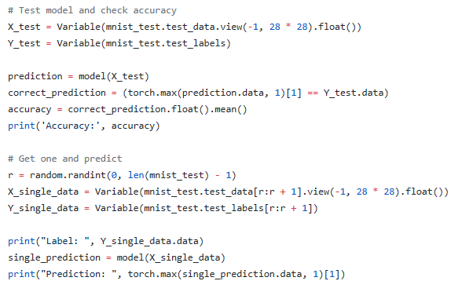
NN for MNIST
https://github.com/hunkim/DeepLearningZeroToAll/blob/master/pytorch/lab-10-2-mnist_nn.py

Slide 10
https://github.com/hunkim/DeepLearningZeroToAll/tree/master/pytorch
https://github.com/hunkim/DeepLearningZeroToAll/blob/master/pytorch/lab-10-3-mnist_nn_xavier.py

Slide 11
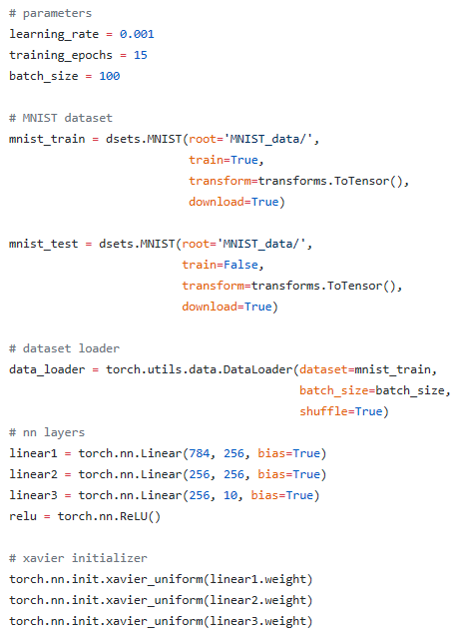
Xavier for MNIST
https://github.com/hunkim/DeepLearningZeroToAll/blob/master/pytorch/lab-10-3-mnist_nn_xavier.py

Slide 12
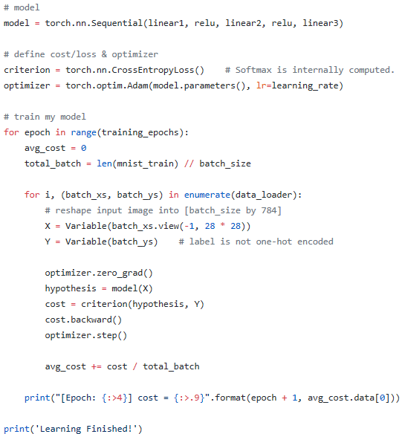
Xavier for MNIST
https://github.com/hunkim/DeepLearningZeroToAll/blob/master/pytorch/lab-10-3-mnist_nn_xavier.py

Slide 13
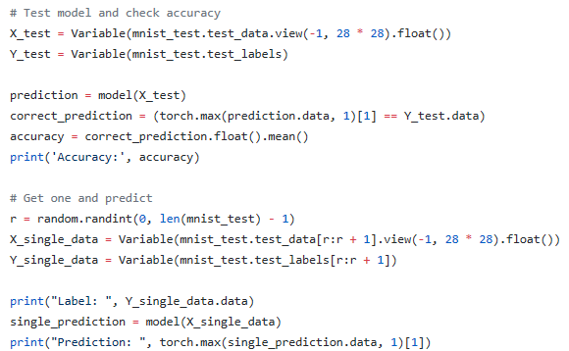
Xavier for MNIST
https://github.com/hunkim/DeepLearningZeroToAll/blob/master/pytorch/lab-10-3-mnist_nn_xavier.py

Slide 14
https://github.com/hunkim/DeepLearningZeroToAll/tree/master/pytorch
https://github.com/hunkim/DeepLearningZeroToAll/blob/master/pytorch/lab-10-4-mnist_nn_deep.py

Slide 15
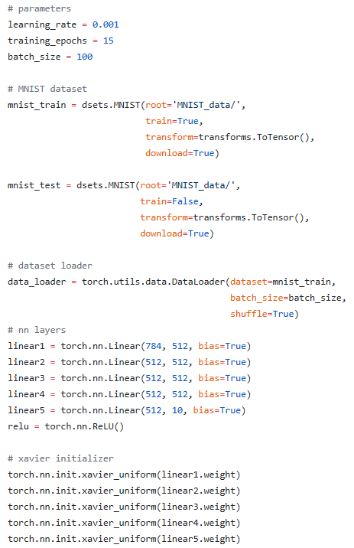
Deep NN for MNIST
https://github.com/hunkim/DeepLearningZeroToAll/blob/master/pytorch/lab-10-4-mnist_nn_deep.py

Slide 16
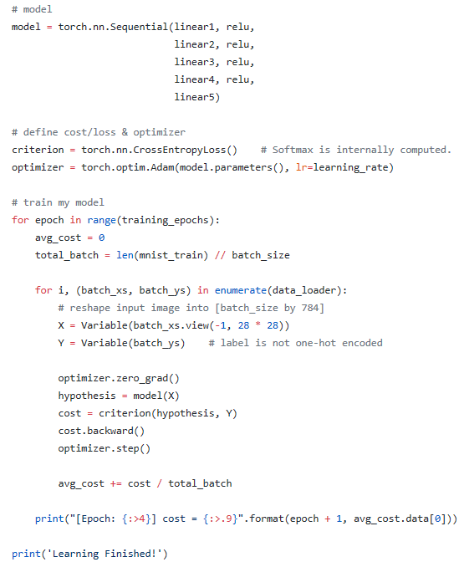
Deep NN for MNIST
https://github.com/hunkim/DeepLearningZeroToAll/blob/master/pytorch/lab-10-4-mnist_nn_deep.py

Slide 17
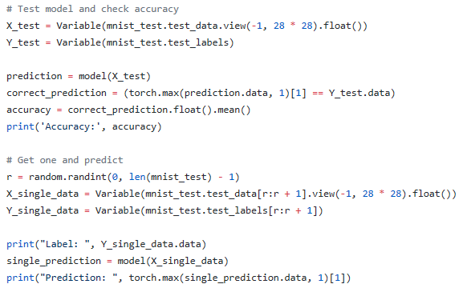
Deep NN for MNIST
https://github.com/hunkim/DeepLearningZeroToAll/blob/master/pytorch/lab-10-4-mnist_nn_deep.py

Slide 18
https://github.com/hunkim/DeepLearningZeroToAll/tree/master/pytorch
https://github.com/hunkim/DeepLearningZeroToAll/blob/master/pytorch/lab-10-5-mnist_nn_dropout.py

Slide 19
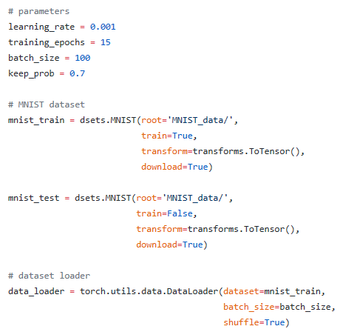
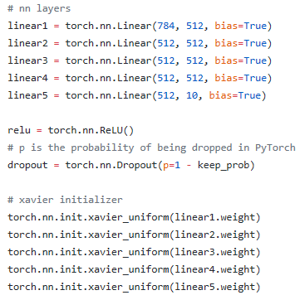
Deep NN with Dropout for MNIST
https://github.com/hunkim/DeepLearningZeroToAll/blob/master/pytorch/lab-10-5-mnist_nn_dropout.py

Slide 20
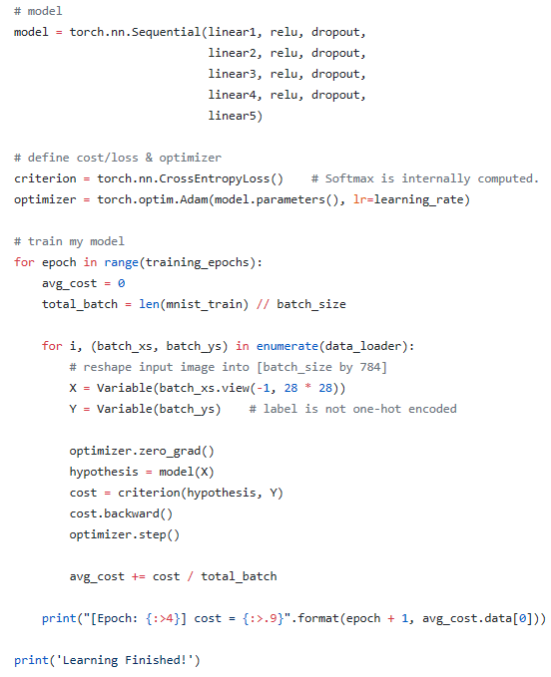
Deep NN with Dropout for MNIST
https://github.com/hunkim/DeepLearningZeroToAll/blob/master/pytorch/lab-10-5-mnist_nn_dropout.py

Slide 21
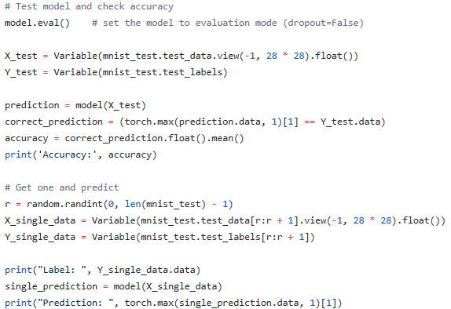
Deep NN with Dropout for MNIST
https://github.com/hunkim/DeepLearningZeroToAll/blob/master/pytorch/lab-10-5-mnist_nn_dropout.py

Slide 22
Summary
Softmax VS Neural Nets for MNIST, 90% and 94.5%
Xavier initialization: 97.8%
Deep Neural Nets with Dropout: 98%

Slide 23
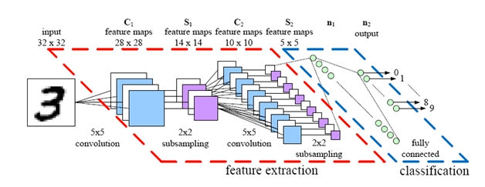
Lab 11
CNN
With PyTorch 0.2.0_2
Sung Kim <hunkim+ml@gmail.com>
Code: https://github.com/hunkim/DeepLearningZeroToAll/

